Slide 1
Online Job Portal Project In Django

Slide 2
Agenda
01
Abstract
02
Statement of Problem
03
Proposed system
04
H/W and S/W Used
05
No.of Modules
06
Conclusion

Slide 3
Abstract
In this project, we attempt to address and minimize the gap between the job seeker and the recruiter through this ONLINE JOB PORTAL (Web Application) using python Django. This is done by considering details of both the job seeker and the recruiter and by applying a variety of filters to satisfy their requirements.
Job seekers can search for vacancies according to their qualifications, skills, and experience as well as a recruiter can easily find suitable and eligible candidates using the job seeker’s resume and profile details. In addition to this, there will be an administrator to manage and authenticate the system services.

Slide 4

Introduction
In this portal different organizations, institutions etc. display/advertise jobs according to their requirements of that the people or job seekers view the different kind of jobs and the further information about the related organization.
Organizations also check the CV’s of job seekers if he/she fulfill the requirements of the organizations, it hire’s or contact them for the jobs.

Slide 5
Statement of Problem
It is not possible for every job seeker to view the newspaper daily and the result is many of the people are become unaware of the jobs.
People have to visit different places for the jobs which is much time consuming and costly.

Slide 6

Existing System
The existing system not providing facilitate communication between employer and employee.
This system does not provide the resume models and resume tips to employee.
This system does not provide the vacancy job details of company.
This system does not provide the news details of jobs.
This system does not provide about FAQs.

Slide 7
The development of this new system contains the following activities, which try to recovery the problems from the previous system:
Secure registration and profile management facilities for system users.
Tracking member’s activities and progress.
Facilitating communication – Through email
Basic and advance admin facilities like add/update members, backup/recovery of data, generating various reports etc.
Provide the solution for making resume help solution.
Provide the facility to view the available job openings in different companies and they can apply for jobs.
Provide the facility to view the frequently asking question by category wise.
Proposed
System

Slide 8
RAM: 2 GB (further increase that as per requirement.)
Hard Disk: 500 GB (further increase that as per requirement.)
Display: 1024 * 768, True Type Color-32
Bit Mouse: Any Normal Mouse.
Keyboard: Any window Supported Keyboard.
Software
Technologies
Front End
HTML
CSS
Back End
Python
Hardware

Slide 9
Modules
Employers are registered through admin authentication and employee can register directly through their profile
The login module gets the username and password of the user.
If the user is already a registered user, then it leads to the user’s dashboard.
In the case of a new user, he/she needs to sign up by giving his/her details
Login
Registration
This module allows adding, deleting and modifying of new, jobs available
Employer can add city, stream, and more details about jobs.
Employer also can view the list of candidates those have applied for jobs , and can add news important for candidates.
Employer can change his password.
Employee
Users should register themselves, they can login using their email and password.
Then they can search job according to their interest.
User can apply for jobs by clicking on the jobs displayed.
Employer

Slide 10
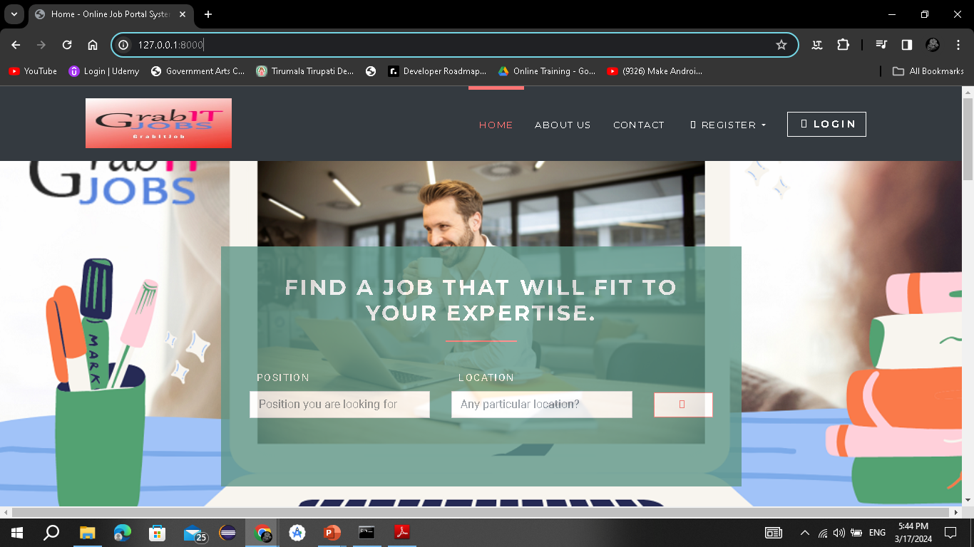
Home page

Slide 11
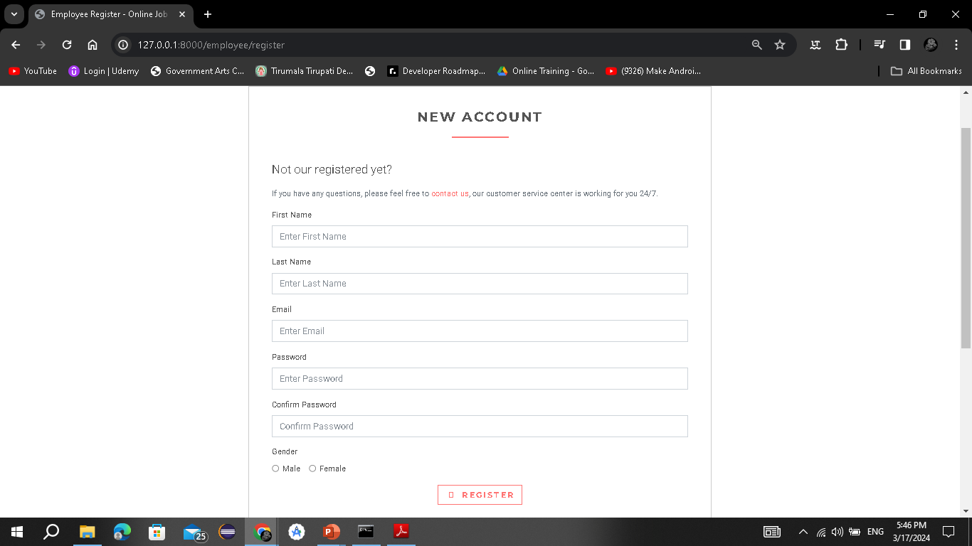
Employee’s Registration Page

Slide 12
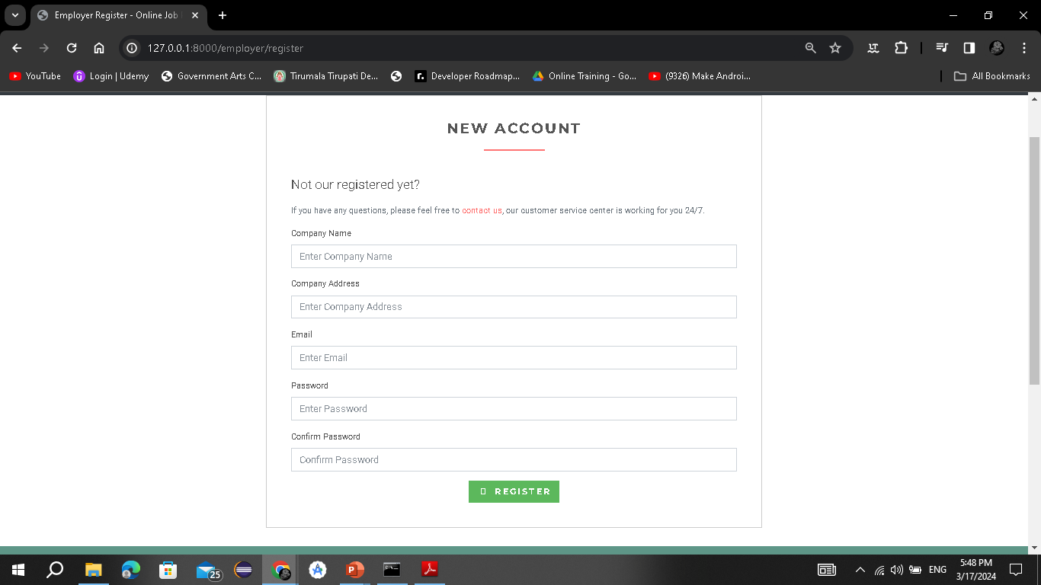
Employer’s Registration Page

Slide 13
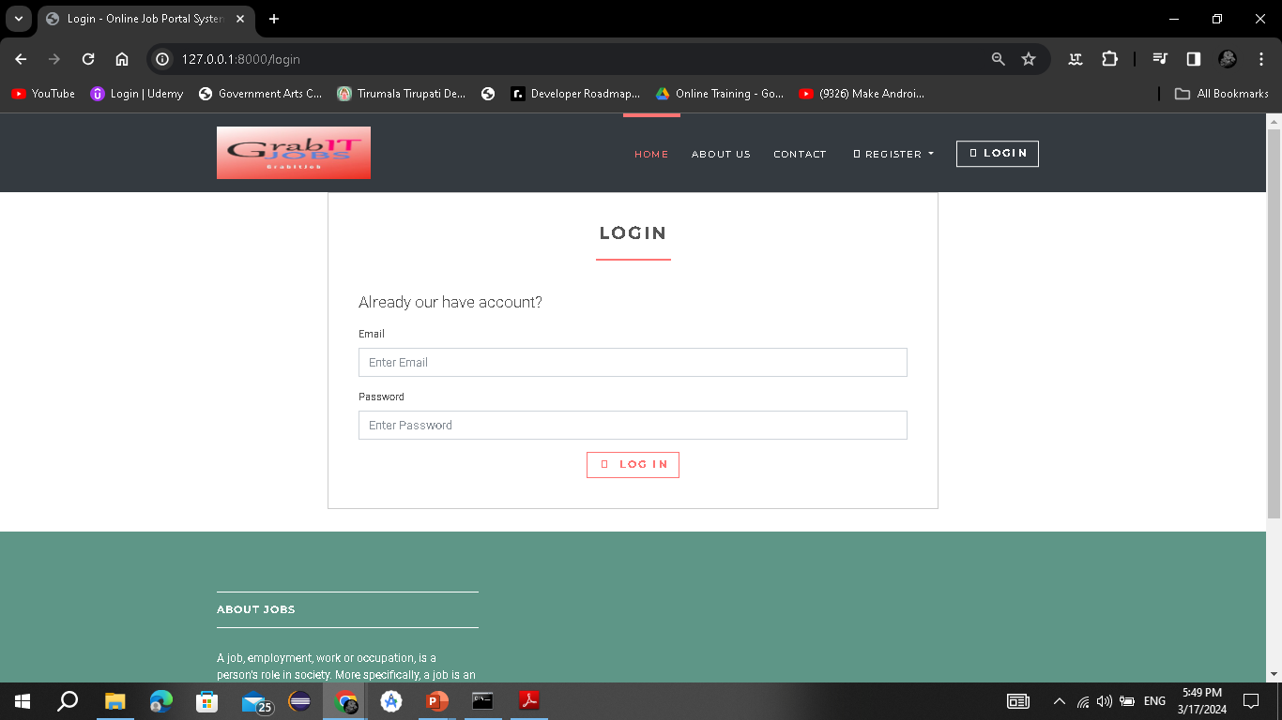
Login Page

Slide 14
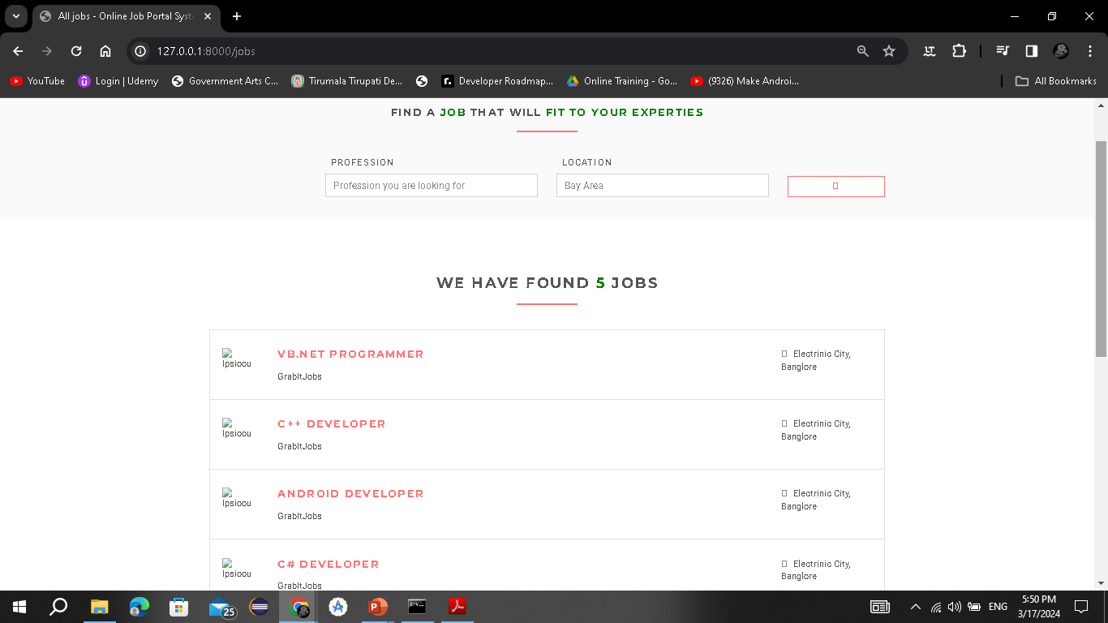
Job Search Page

Slide 15
Conclusion
Job Search Portals stands as a revolutionizing element in the sphere of recruitment. They act as a communication bridge between applicants and recruiters facilitating their requirements. This application helps organizations to have a greater exposure to the candidate pool and also job seekers facilitating wide search of jobs matching their interests.
The android application provides flexibility to the jobseekers to view the openings and applied jobs without the need to carry a laptop. This application provides an enhanced user experience for both employer and jobseeker. It provides user friendly interface which facilitates in reaching wide range of audience.

Slide 16


